Slide 1

Machine Learning Visualization and Interview Experience
Yixin Su
2024-05-20

Slide 2
Biography
Education
Research Interests
Bachelor: XJTLU, Information & Computing Science
Master: The University of Melbourne, Computer Science
Ph.D.: The University of Melbourne, Recommender Systems
Possess research experience in the fields of recommendation systems and graph neural networks, with multiple papers published in top-tier conferences. Experienced in computational advertising mechanism models. Interested in large language model algorithms and applications.
Work Experience
Baidu. Inc R&D 2023.5 – now
Intel Asia-Pacific AI Framework Engineer 2022.10 – 2023.4
DAMO Academy Research Intern 2021.11 – 2022.4
Chinese Academy of Sciences Research Intern 2016.11 – 2017.3
Selected Papers
Yixin Su, Yunxiang Zhao, Sarah Erfani, Junhao Gan, Rui Zhang, Detecting Arbitrary Order Beneficial Feature Interactions for Recommender Systems. SIGKDD 2022.
Yixin Su, Rui Zhang, Sarah Erfani, Junhao Gan, Neural Graph Matching based Collaborative Filtering. SIGIR 2021.
Yixin Su, Rui Zhang, Sarah Erfani, Zhenghua Xu, Detecting Beneficial Feature Interactions for Recommender Systems. AAAI 2021.
Rui Zhang*, Yixin Su*, Bayu D. Trisedya, Xiaoyan Zhao, Min Yang, Hong Cheng, Jianzhong Qi, Autoalign: fully automatic and effective knowledge graph alignment enabled by large language models, TKDE 2024.
Yunxiang Zhao, Jianzhong Qi, Bayu D. Trisedya, Yixin Su, Rui Zhang, Hongguang Ren, Learning Region Similarities via Graph-based Deep Metric Learning, TKDE 2023.
Xinxin Su, Zhen Huang, Yixin Su, Bayu D. Trisedya, Yunxiang Zhao, and Yong Dou, Hierarchical Shared Encoder with Task-specific Transformer Layer Selection for Emotion-Cause Pair Extraction, TAFFC 2024.
Honors
Ph.D. full scholarship supported by China Scholarship Council (2018-2022)
Honorable Ment ion of Mathemat ical Contest in Modeling Compet it ion (2014)
Meritorious Winner of Mathemat ical Contest in Modeling Compet it ion (2013)
Meritorious Winner of China Mathemat ical Contest in Modeling (2012)

Slide 3


Introduction to Machine Learning
Evaluation Metrics: Confusion Matrix
AUC in Recommender Systems
Interview Experience
Recommender Systems – Feature Interaction
Large Language Model Principle Visualization
Content

Slide 4

01
Introduction to Machine Learning

Slide 5

Introduction to Machine Learning
What is Machine Learning
Machine Learning is a branch of artificial intelligence that involves the construction and study of algorithms that can learn from and make decisions based on data.
Machine Learning vs Traditional Methods
Traditional Methods: Rule-based decisions
Traditional programming relies on explicitly defined rules and logic set by developers, offering stability but lacking adaptability to new scenarios.
Machine Learning: Data-drive decisions
Machine learning models learn from vast datasets to derive patterns and make decisions, adapting continually to new data.

Slide 6



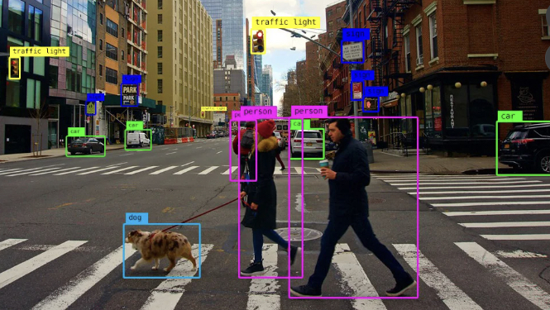
Machine Learning Applications
Natural Language Processing
Recommender Systems
Game Playing
Computer Visions

Slide 7
Machine Learning Process
Problem Definition
Data Collection
Model Design
What problems we want to solve, recommendation, object detection, text generation, etc.
Table data, image data, text data
Regression model, classification model, reinforcement learning model
Deployment
Optimization
Evaluation Metrics
Online system, Offline system
SGD, Adam
Precision, Recall, Area under Curve, BLEU

Slide 8
02
Evaluation Metrics Visualization

Slide 9
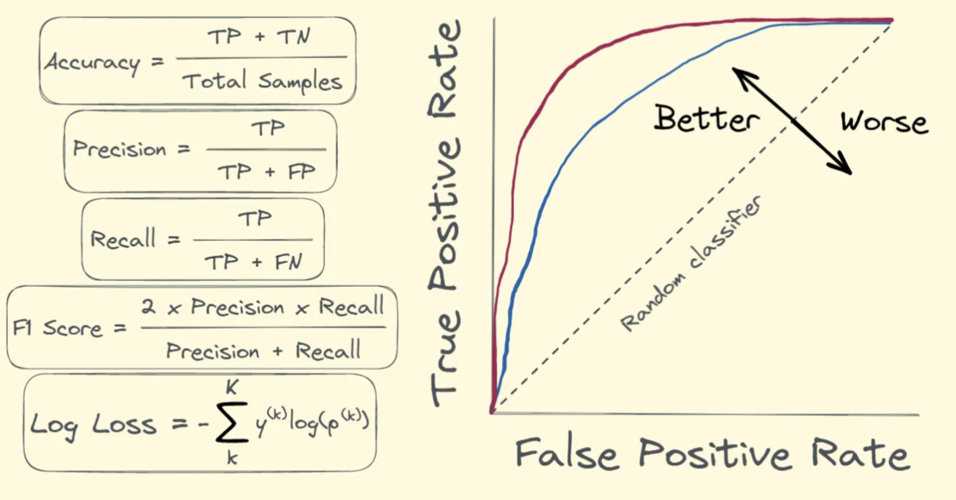
Evaluation Metrics Overview
What are Evaluation Metrics
Evaluation metrics are quantifiable measures used to assess the performance of machine learning models. They help determine how well a model's predictions match the actual data.
Roles of Evaluation Metrics
Metrics guide the model selection and tuning process, providing insights into how models perform under various conditions. They are crucial for validating model accuracy, generalizability, and effectiveness in real-world scenarios.

Slide 10
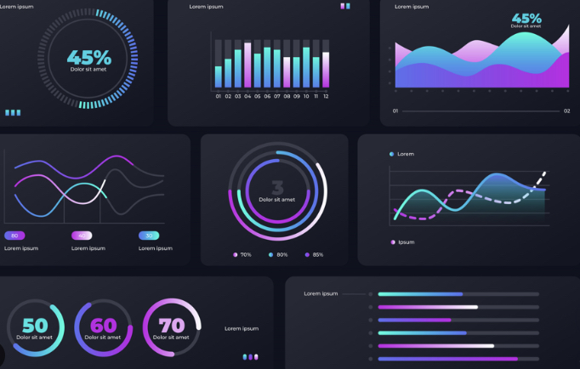
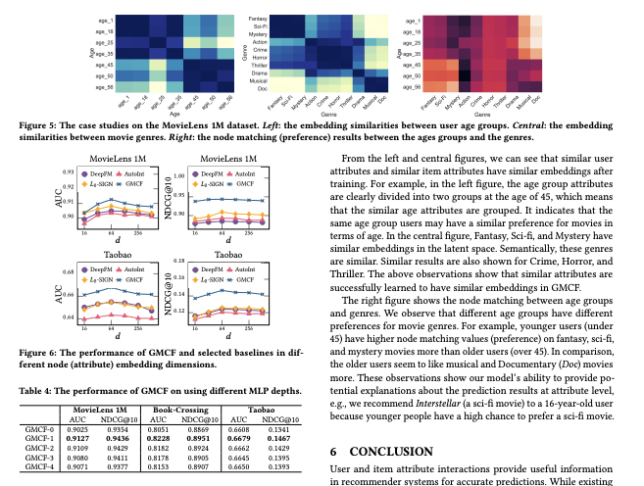
Visualizing Evaluation Metrics
Why visualize evaluation metrics
Enhanced Understanding: "Visual tools help interpret complex results more easily, allowing for quicker and more intuitive understanding of model performance."
Detailed Analysis: "Visualization provides a detailed analysis of the strengths and weaknesses of a model, highlighting areas that need improvement."
Comparison of Models: "Plots and graphs allow for the direct comparison of multiple models, facilitating the selection of the best model based on visual evidence."

Slide 11
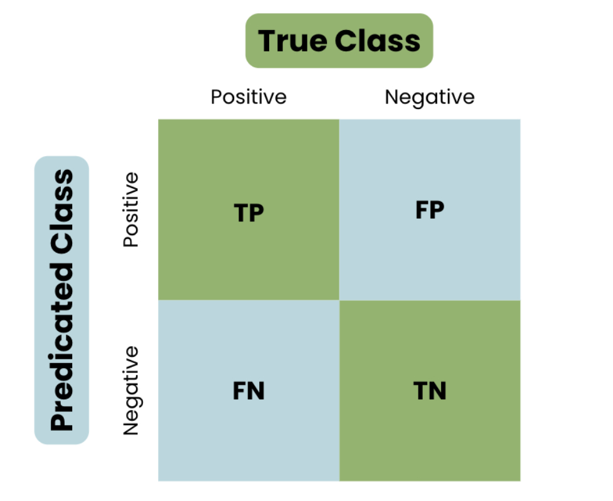
Confusion Matrix
What is confusion Matrix
A confusion matrix is a table used to describe the performance of a classification model. It compares the predicted labels with the actual labels to give insight into the accuracy and types of errors the model makes.

Slide 12
Confusion Matrix
True Positive (TP):
Correctly predicted positive cases.
”It’s True and I correctly predict it’s True”
True Negative (TN):
Correctly predicted negative cases.
“It’s False and I correctly predict it’s False”
False Positive (FP):
Incorrectly predicted positive cases.
“It’s False but I wrongly predict it’s True”
False Negative (FN):
Incorrectly predicted negative cases.
“It’s True but I wrongly predict it’s False”

Slide 13
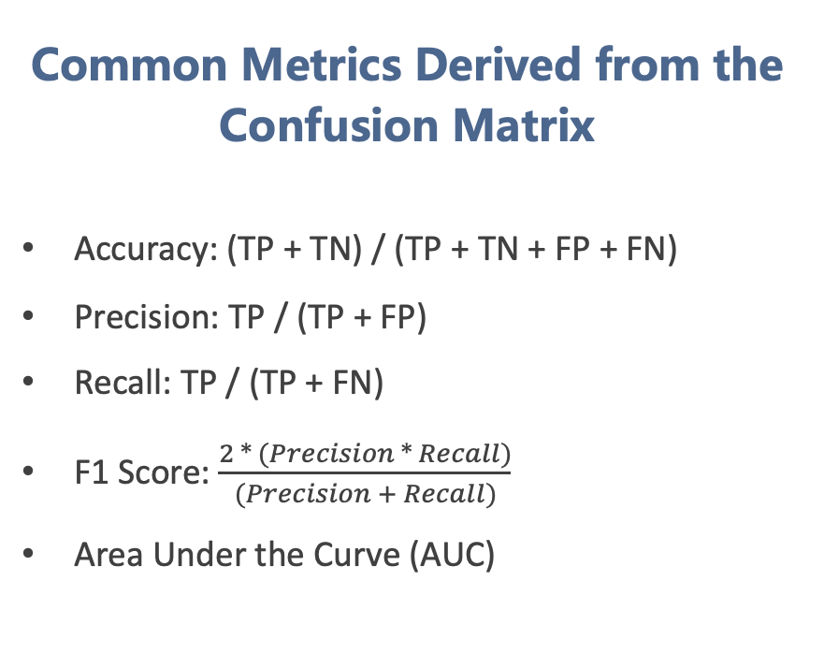
Confusion Matrix
Common Metrics Derived from the Confusion Matrix
Accuracy: (TP + TN) / (TP + TN + FP + FN)
Precision: TP / (TP + FP)
Recall: TP / (TP + FN)
F1 Score: $\frac{2 ∗ (Precision ∗ Recall)}{(Precision + Recall)}$
Area Under the Curve (AUC)

Slide 14
Confusion Matrix - Accuracy
A model to predict whether a patient got a cancer.
Truth: there are 100 patients, 10 have cancer (positive) and 90 have not (negative).
Now there is a model makes a prediction. In 10 positive cases, the model got 2 correct and 8 wrong. In 90 negative cases, the model got 87 correct and 3 wrong.
Accuracy: (TP + TN) / (TP + TN + FP + FN)
(2 + 87) / (2 + 87 + 3 + 8) = 89%
2
3
8
87

Slide 15
Confusion Matrix - Accuracy
There is a model to predict whether a patient got a cancer. Now there are 100 patients, 10 have cancer (positive) and 90 have not (negative).
Can we say that the model is a good model?
In a more simple example, if we just predict all negative, we will get 90% accuracy!
0
0
10
90

Slide 16
Confusion Matrix - Precision
There is a model to predict whether a patient got a cancer. Now there are 100 patients, 10 have cancer (positive) and 90 have not (negative).
Now there is a model got a prediction. In 10 positive cases, the model got 2 correct and 8 wrong. In 90 negative cases, the model got 87 correct and 3 wrong.
2
3
Precision: TP / (TP + FP)
2 / (2 + 3) = 40%
Meaning: in all the 5 cases predicted as positive, 40% of the case are correctly predicted.
8
87

Slide 17
Confusion Matrix - Recall
There is a model to predict whether a patient got a cancer. Now there are 100 patients, 10 have cancer (positive) and 90 have not (negative).
Now there is a model got a prediction. In 10 positive cases, the model got 2 correct and 8 wrong. In 90 negative cases, the model got 87 correct and 3 wrong.
2
3
Recall: TP / (TP + FN)
2 / (2 + 8) = 20%
Meaning: in all the 10 positive cases, 20% of the case are correctly predicted.
8
87

Slide 18
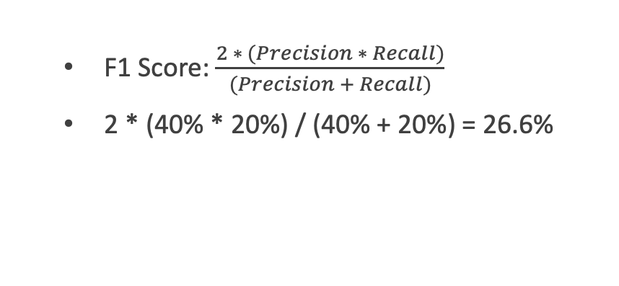
Confusion Matrix – F1-score
There is a model to predict whether a patient got a cancer. Now there are 100 patients, 10 have cancer (positive) and 90 have not (negative).
Now there is a model got a prediction. In 10 positive cases, the model got 2 correct and 8 wrong. In 90 negative cases, the model got 87 correct and 3 wrong.
2
3
F1 Score: $\frac{2 ∗ (Precision ∗ Recall)}{(Precision + Recall)}$
2 * (40% * 20%) / (40% + 20%) = 26.6%
8
87

Slide 19
03
AUC in Recommender Systems

Slide 20
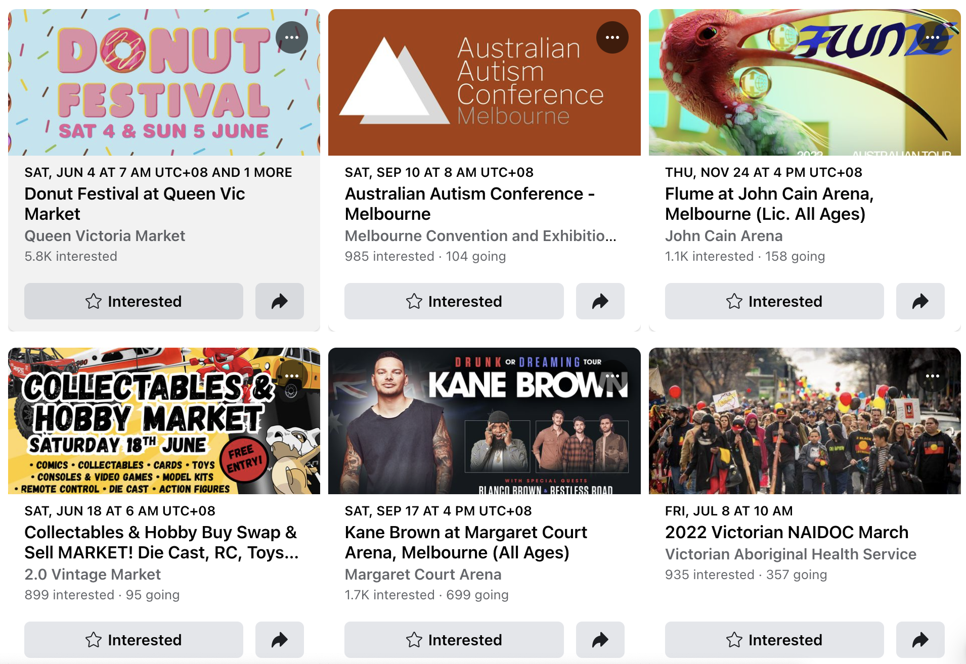

Recommender Systems
Events recommendation in Facebook.
Music recommendation in Spotify.
Notes:
Recommender systems are everywhere.
Here are some real world examples.
Event: locations, previously participated events or your profle.
Music: previously listened music our the music you liked.

Slide 21
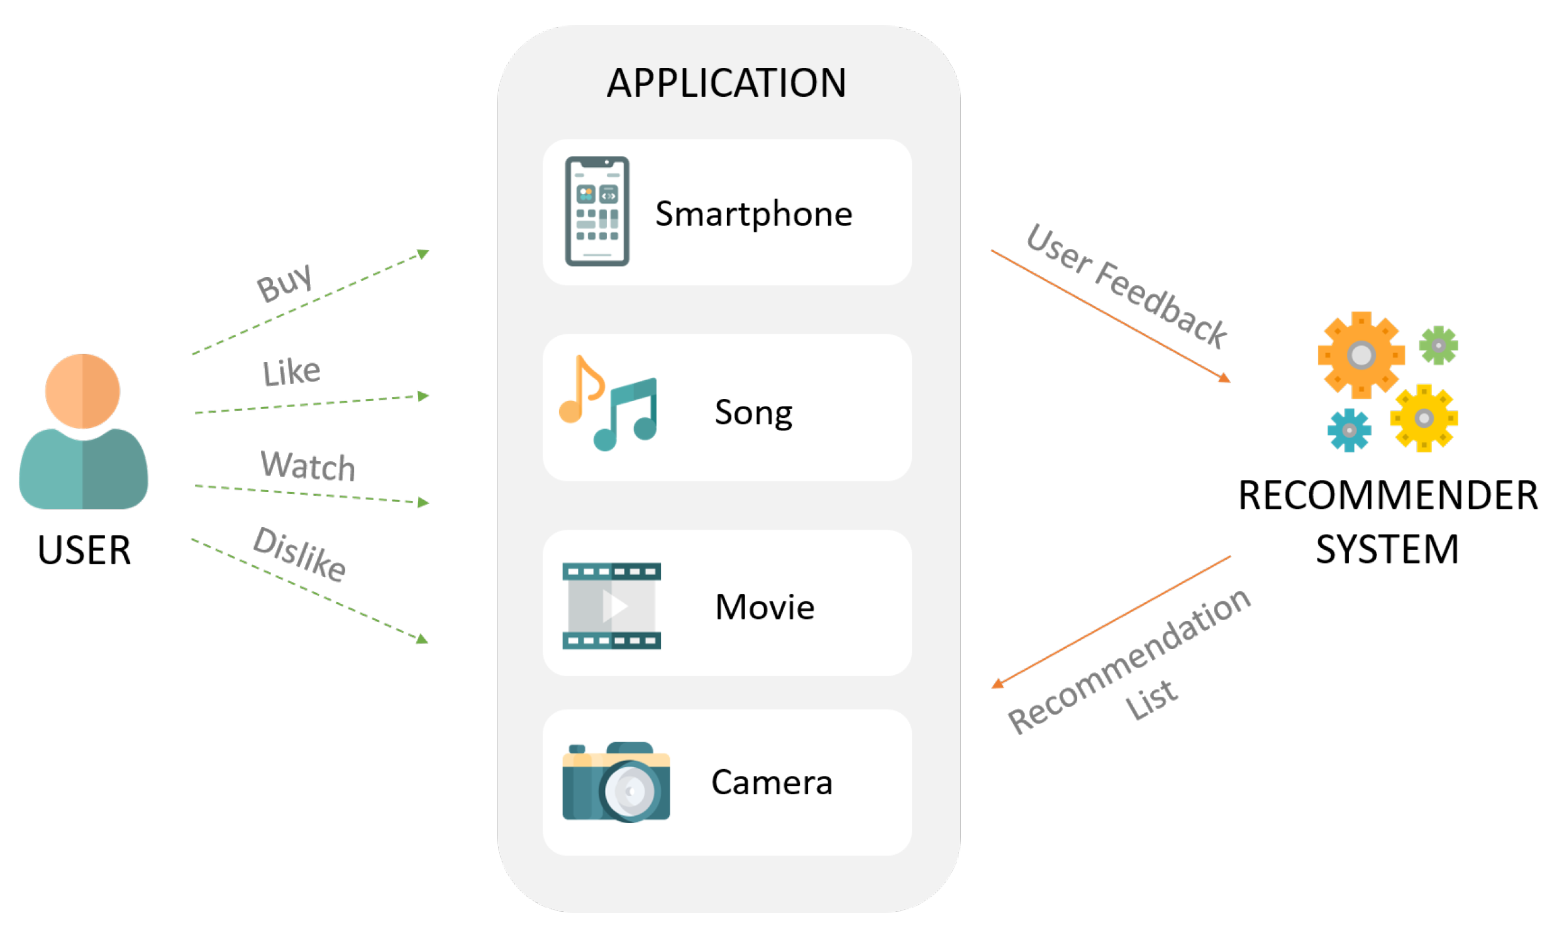
Recommender Systems
What are Recommender Systems
Recommender systems are algorithms designed to suggest relevant items to users (like books, movies, or products) based on their past preferences and behaviors. These systems are prevalent in e-commerce and online media sites, enhancing user experience by personalizing content.
Evaluating Recommender Systems
The quality of a recommender system is judged by how effectively it predicts the preferences of users and influences their satisfaction and engagement. Evaluation metrics are crucial for assessing these aspects.

Slide 22

Recommender Systems
Recommender Systems Metrics
Accuracy Metrics: "Precision, Recall, – measure how accurately the system predicts user likes and dislikes."
Ranking Metrics: " AUC, NDCG (Normalized Discounted Cumulative Gain) – assess how well the system ranks recommended items."
Diversity and Novelty: "Evaluate how varied and new the recommendations are to individual users."

Slide 23
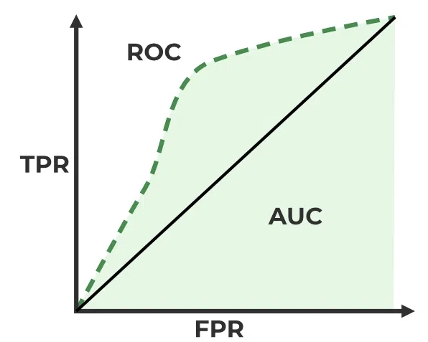
Recommender Systems Metrics: AUC
Definition
AUC (Area Under the Curve) is a performance metric for classification and ranking models, representing the probability that a randomly chosen positive instance is ranked higher than a randomly chosen negative instance.
In recommender systems, AUC evaluates how well the system distinguishes between relevant and irrelevant items for a user.

Slide 24
Recommender Systems Metrics: AUC
Calculation
The ROC (Receiver Operating Characteristic) curve plots the True Positive Rate (TPR) against the False Positive Rate (FPR) across different thresholds.
For a case, a model predict it’s probability of being positive is 0.6.
Threshold 0.5: It is predicted as positive
Threshold 0.7: It is predicted as negative

Slide 25
Recommender Systems Metrics: AUC
Calculation
The ROC (Receiver Operating Characteristic) curve plots the True Positive Rate (TPR) against the False Positive Rate (FPR) across different thresholds.
For each threshold, we can calculate TPR and FPR:
TPR (Recall) = TP / (TP + FN)
FPR = FP / (FP + TN)

Slide 26
Recommender Systems Metrics: AUC (example)
In the cancer example, we have 5 cases:
Case 1: y = 1 (positive), predict = 0.9
Case 2: y = 1 (positive), predict = 0.3
Case 3: y = 0 (negative), predict = 0.4
Case 4: y = 1 (positive), predict = 0.6
Case 5: y = 0 (negative), predict = 0.2

Slide 27
Recommender Systems Metrics: AUC (example)
Threshold 1.0:
Case 1: y = 1 (positive), predict = 0.9 (FN)
Case 2: y = 1 (positive), predict = 0.3 (FN)
Case 3: y = 0 (negative), predict = 0.4 (TN)
Case 4: y = 1 (positive), predict = 0.6 (FN)
Case 5: y = 0 (negative), predict = 0.2 (TN)
TPR (Recall) = TP / (TP + FN) = 0
FPR = FP / (FP + TN) = 0
0
0
3
2

Slide 28
Recommender Systems Metrics: AUC (example)
Threshold 0.9:
Case 1: y = 1 (positive), predict = 0.9 (TP)
Case 2: y = 1 (positive), predict = 0.3 (FN)
Case 3: y = 0 (negative), predict = 0.4 (TN)
Case 4: y = 1 (positive), predict = 0.6 (FN)
Case 5: y = 0 (negative), predict = 0.2 (TN)
TPR (Recall) = TP / (TP + FN) = 0.33
FPR = FP / (FP + TN) = 0
1
0
2
2

Slide 29
Recommender Systems Metrics: AUC (example)
Threshold 0.6:
Case 1: y = 1 (positive), predict = 0.9 (TP)
Case 2: y = 1 (positive), predict = 0.3 (FN)
Case 3: y = 0 (negative), predict = 0.4 (TN)
Case 4: y = 1 (positive), predict = 0.6 (TP)
Case 5: y = 0 (negative), predict = 0.2 (TN)
TPR (Recall) = TP / (TP + FN) = 0.66
FPR = FP / (FP + TN) = 0
2
0
1
2

Slide 30
Recommender Systems Metrics: AUC (example)
Threshold 0.4:
Case 1: y = 1 (positive), predict = 0.9 (TP)
Case 2: y = 1 (positive), predict = 0.3 (FN)
Case 3: y = 0 (negative), predict = 0.4 (FP)
Case 4: y = 1 (positive), predict = 0.6 (TP)
Case 5: y = 0 (negative), predict = 0.2 (TN)
TPR (Recall) = TP / (TP + FN) = 0.66
FPR = FP / (FP + TN) = 0.5
2
1
1
1

Slide 31
Recommender Systems Metrics: AUC (example)
Threshold 0.3:
Case 1: y = 1 (positive), predict = 0.9 (TP)
Case 2: y = 1 (positive), predict = 0.3 (TP)
Case 3: y = 0 (negative), predict = 0.4 (FP)
Case 4: y = 1 (positive), predict = 0.6 (TP)
Case 5: y = 0 (negative), predict = 0.2 (TN)
TPR (Recall) = TP / (TP + FN) = 1.0
FPR = FP / (FP + TN) = 0.5
3
1
0
1

Slide 32
Recommender Systems Metrics: AUC (example)
Threshold 0.2:
Case 1: y = 1 (positive), predict = 0.9 (TP)
Case 2: y = 1 (positive), predict = 0.3 (TP)
Case 3: y = 0 (negative), predict = 0.4 (FP)
Case 4: y = 1 (positive), predict = 0.6 (TP)
Case 5: y = 0 (negative), predict = 0.2 (FP)
TPR (Recall) = TP / (TP + FN) = 1
FPR = FP / (FP + TN) = 1
3
2
0
0

Slide 33
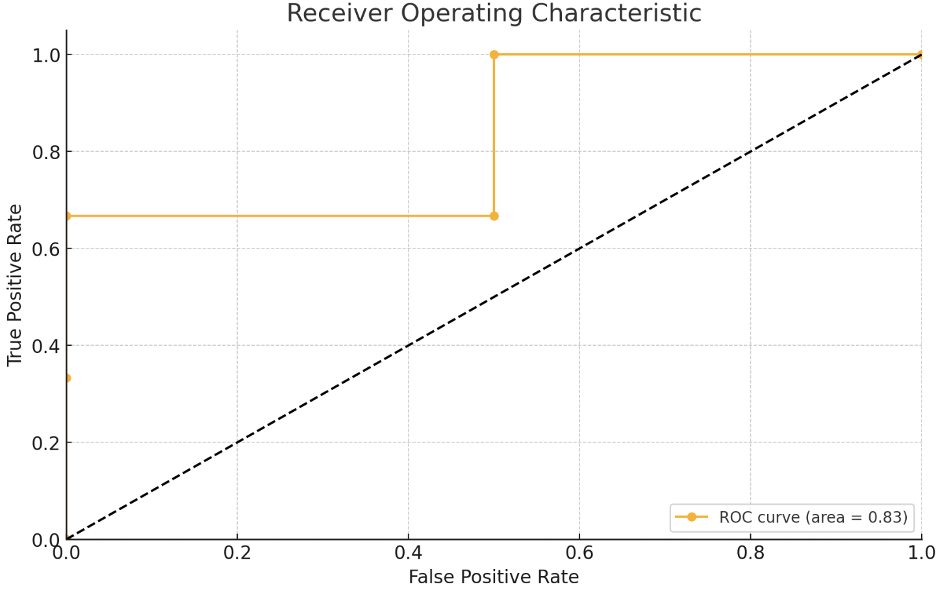
Recommender Systems Metrics: AUC (example)
Threshold | TPR | FPR
1.0 | 0.0 | 0.0
0.9 | 0.33 | 0.0
0.6 | 0.66 | 0.0
0.4 | 0.66 | 0.5
0.3 | 1.0 | 0.5
0.2 | 1.0 | 1.0
AUC = 0.66 * 0.5 + 1.0 * 0.5 = 0.83

Slide 34
04
Interview Experience

Slide 35




Applying a Job
Apply for the job (preparing CV)
Coding test – three Leecode algorithm problems
General tests – Personality test / Cognitive test
HR interview (optional) – some general questions
The first round technical interview – technical questions, coding test, etc.
The second round technical interview – similar to the first round, but deeper
The third round…
Manager interview – whether you are a good employee
HR interviews – personality, payment, start time, etc..

Slide 36
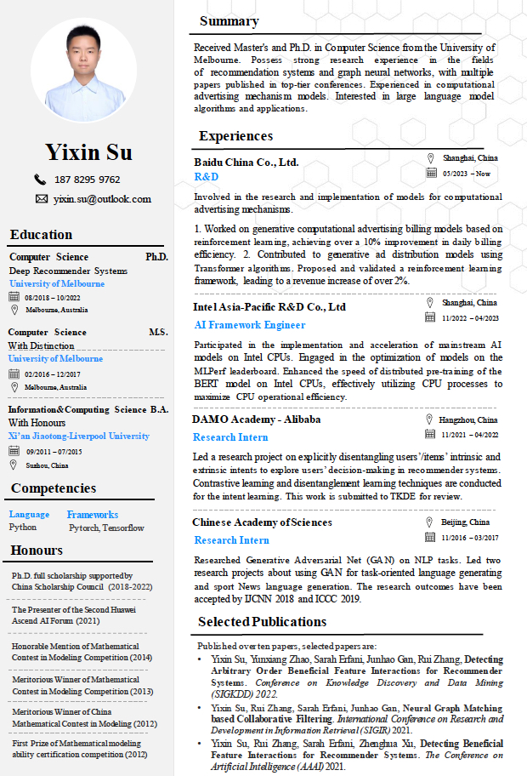
CV/Resume
Content
Summary (highlights)
Basic Information
Education
Experience
Skills
Honour
Publications

Slide 37

CV/Resume - Summary
A seasoned HR professional with 15 years of HR in house and 8 years consulting both in China and US. Good at organizational structure adjustment, compensation & benefits, succession management and career management.
He is honest, dependable and incredibly dedicated, he is a team player, always inspired by challenges.
Highlights:
10 years HR Director in leading multi-national companies;
Implemented 2 major restructuring projects;
Established share service center for top tier retailer;
Designed and conducted leadership pipeline initiatives;
English is a working language.
A job description

Slide 38

CV/Resume - Education
Each education should include the institution, major, duration, place, and the most relevant courses you have learned.
Course:
The name of the course
The most useful skills has learned (in one or two phrases), e.g., SQL, Spark, RNN

Slide 39
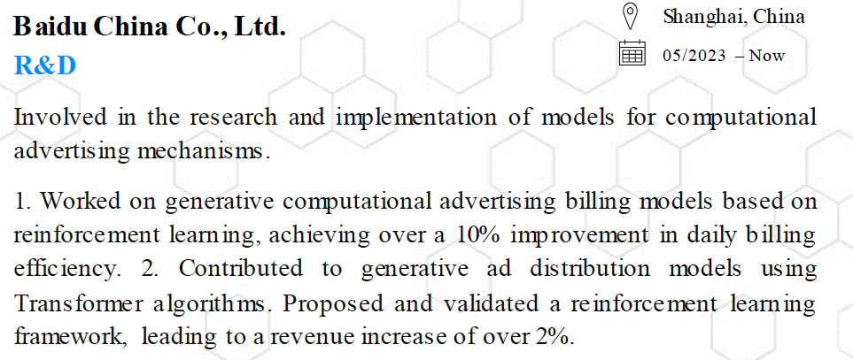
CV/Resume - Experience
Experience includes working experience, internship experience, school experience (e.g., 社团)
Each experience should include the institution, place, duration, role, and a short summary to highlight the experience.
Summary:
Talk about something that the interviewer is interested (i.e., related to their job or show that you know something)
Including the description of your roles, the tools/skills used/learned, and the achievements (best use numbers).

Slide 40
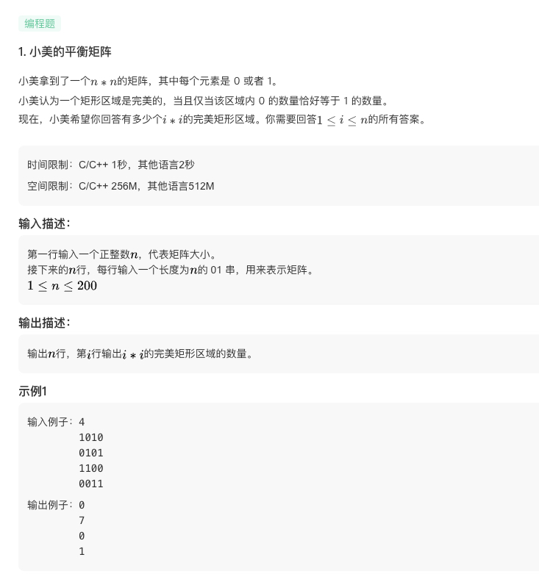
Coding Test
Test forms:
Testing is on the browser
2 hours
3-5 algorithm problems from easy to hard
Coding using your preferred language (java, c++, python, etc.)
Code should contain: receive input (optional), algorithm, output the result.
You can test your code while coding

Slide 41
Coding Test
Problems:
Description
Time constrain
Input format
Output format
example

Slide 42

Coding Test
Coding area:
Select language
ACM/Automatic mode
Coding area
Self testing

Slide 43
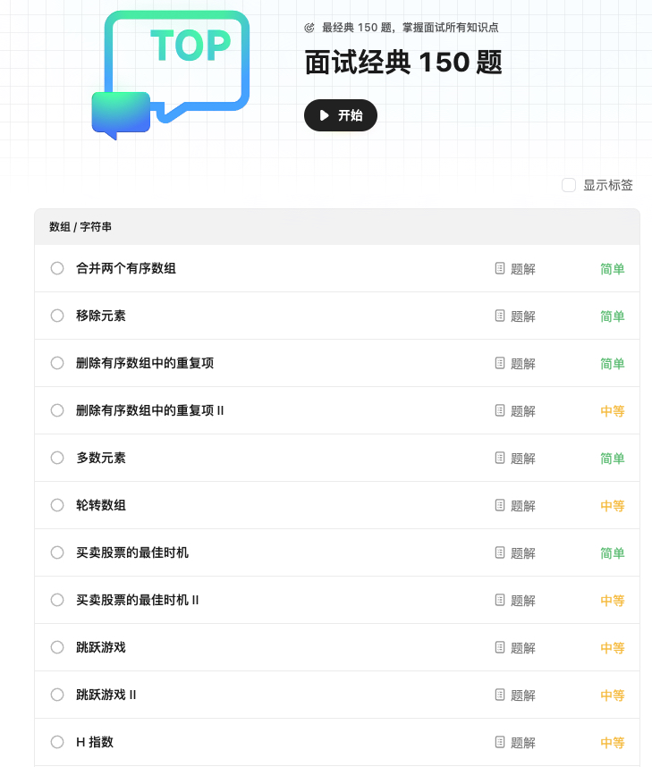
Coding Test
Practice Suggestions
Website: Leecode/nowcoder
Leecode: https://leetcode.cn/
Nowcoder: https://www.nowcoder.com/exam/oj
One problem a day to keep familiar with coding
Be professional with different kinds of problems:
Two pointers/Sliding Window/Linked List/Tree/Binary Search/Dynamic Programming/Searching
100+ easy, 200+ mid, 50+ hard

Slide 44

Technical Interview
Self-Introduction
1-2 min
Should have logic, in time order, in skill growth order, etc.
Talk more about content that you are familiar with.
Talk more about the content that are related to job.
Technical questions related to your experience
May ask details of your project, your work, or experience.
Be very familiar with your project/work/ experience.
Prepare one or two stories about technical difficulties you encountered and how you solved.

Slide 45
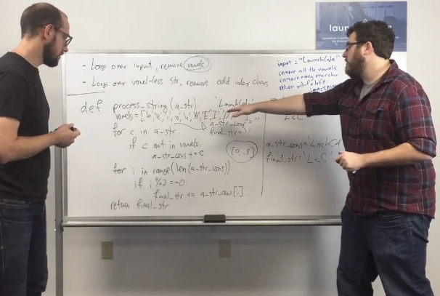
Technical Interview
Technical questions related to skills
Prepare for the skills/knowledge the job required.
Prepare it like having an exam.
Coding test
More flexible
Maybe more easy
Test the problem solving ability in 1v1 situation.
May need to write the pseudo code.
Ask back
Less than 3 questions
At least one to show that you are interested in the job
e.g., job related, expectation on you; department related, the position of the department on the company.
Do not ask your performance in the interview.
Do not ask about the salary information.

Slide 46
05
Recommender Systems – Feature Interaction Detection

Slide 47


Recommender Systems
Recommender systems play a key role in addressing information overload issues in many Web applications
e-commerce
social media platforms
lifestyle apps
The core of recommender systems is to predict how likely a user will select an item (e.g., purchase, click).
?
User
Item
Notes:
My research domain is about recommender systems.
It plays a central role in …
Example… Then, recommender systems can pick up a few items that you are interested from vast number of candidate items

Slide 48
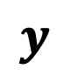
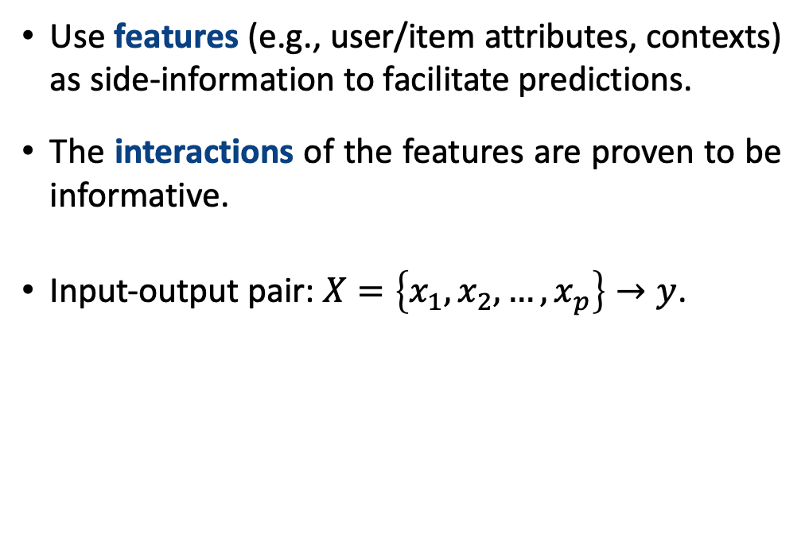
Feature Interactions in Recommender Systems
Feature interactions, e.g., red shirts
Use features (e.g., user/item attributes, contexts) as side-information to facilitate predictions.
The interactions of the features are proven to be informative.
Input-output pair: $X=\left\{x_{1},x_{2},…,x_{p}\right\}→y$.
Style
$$y$$
Color
Texture
User
Item
Brand
Features
Figure 1. Recommender systems considering feature interactions.
Notes:
While designing the recommendation algorithms, features are important side-information.
Common features include user attributes (gender, age), item attributes (style, color), and contexts like weather and time.
Then the input-output of a recommendation algorithm considering features can be formulated as

Slide 49
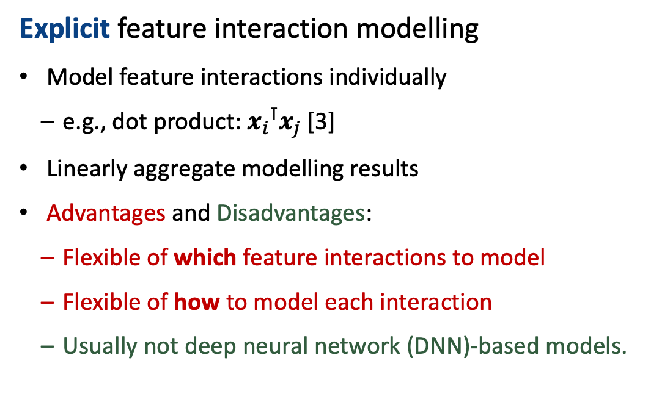
Explicit vs. Implicit Feature Interaction Modelling
Explicit feature interaction modelling
Model feature interactions individually
e.g., dot product: ${x_{i}}^{⊺}x_{j}$ [3]
Linearly aggregate modelling results
Advantages and Disadvantages:
Flexible of which feature interactions to model
Flexible of how to model each interaction
Usually not deep neural network (DNN)-based models.
Figure 2. Explicit feature interaction modelling.
[3] Steffen Rendle. Factorization Machines. ICDM 2010.
Notes:
There are basically two ways to model feature interactions: explicit and implicit.
Explicit feature interaction first construct every feature interaction, and model them individually.
Then it aggregate the modelling, usually linearly like summing up the results as the final prediction.
It is a very popular method in early non-DNN-based recommender systems.
Advantage:
It can directly leverage regression models.
We can flexibly design how each feature interaction is modeled and aggregated, provide the interpretability.
However, with the development of deep neural networks, there is a high demand to leverage DNNs in recommender systems.

Slide 50
Explicit vs. Implicit Feature Interaction Modelling
Implicit feature interaction modelling
Model and aggregate feature interactions in a deep neural network
e.g., concatenate and feed into a multi-layer perceptron [1]
Advantages and Disadvantages:
More accurate prediction
Cannot choose which interactions to model
Cannot choose how to model each interaction
Less effective interaction modelling [2]
Figure 3. Implicit feature interaction modelling.
[1] Cheng et al. Wide & Deep Learning for Recommender Systems. RecSys 2016.
[2] Song et al., Autoint: Automatic Feature Interaction Learning via Self-attentive Neural Networks. CIKM 2019.
Notes:
So the implicit feature interaction developed when people try to leverage DNNs for feature interaction modelling.
They usually put all feature together and feed into a neural network.
This way of modelling does not know how each feature interaction is modeled and how they are aggregated due to the black box natural of dnn.
It is called implicit modelling.
The advantages of this method is that it is simple in model design since we do not really care about how interactions are modelled.
Also, since it uses dnns, the accuracy is often satisfiable.
We explore to explicitly model feature interactions using deep neural network. Specifically, we leverage graph neural network framework for feature interactions modelling, and we will detail it shortly.

Slide 51
Research Questions
Can we combine the advantages of both explicit and implicit methods?
Deep neural network-based explicit feature interaction modelling
Notes:
Focus on two questions or two aspects of explicit feature interaction modelling for recommender systems.
We also tackle another research questions in my phd study but we do not focus on it in this seminar.

Slide 52
Research Questions
RQ1. There are vast number of possible feature interactions. However, only part of them are beneficial to the recommendation.
How to detect these beneficial feature interactions for recommendation predictions?
RQ2. Feature interactions serve as different roles in recommender systems, e.g., profile construction, preference matching, decision-making factor learning.
How to categorize and model these feature interactions to generate more accurate recommendation predictions?
RQ3. Matrix Factorization (MF) is one of the most popular traditional recommendation algorithms. However, it does not consider feature interactions.
How to enable feature interaction modelling in matrix factorization?
Notes:
Under the framework, we
focus on two research questions explicit feature interaction modelling for recommender systems.
We also tackle another research questions in my phd study but we do not focus on it in this seminar.

Slide 53
Our Work
RQ1. How to detect beneficial feature interactions for recommendation predictions?
Detecting Beneficial Feature Interactions for Recommender Systems (AAAI 2021)
Detecting Arbitrary Order Beneficial Feature Interactions for Recommender Systems (KDD 2022)
Notes:
We complete 5 works. We will talk 4 most important works, which explore the solutions to our first two research questions.

Slide 54

Our Work
Notes:
Let me introduce our work in more detail.

Slide 55
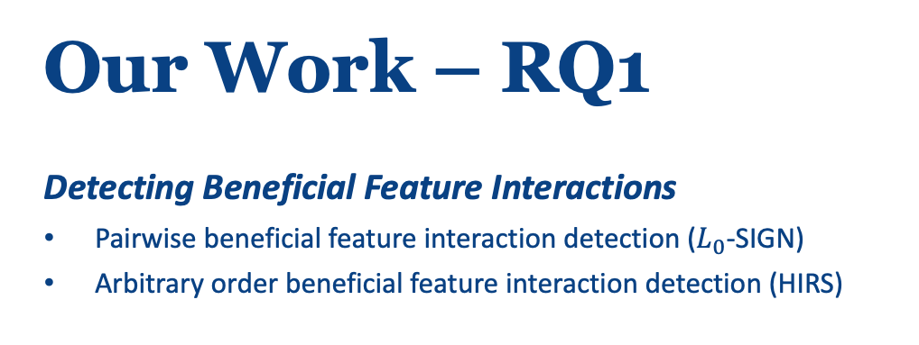
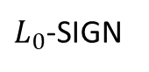
Our Work – RQ1
Detecting Beneficial Feature Interactions
Pairwise beneficial feature interaction detection ($L_{0}$-SIGN)
Arbitrary order beneficial feature interaction detection (HIRS)
$L_{0}$-SIGN
HIRS

Slide 56
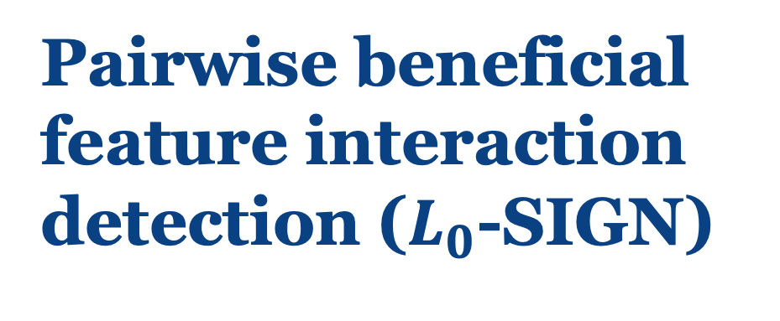
Pairwise beneficial feature interaction detection ($L_{0}$-SIGN)
AAAI 2021

Slide 57
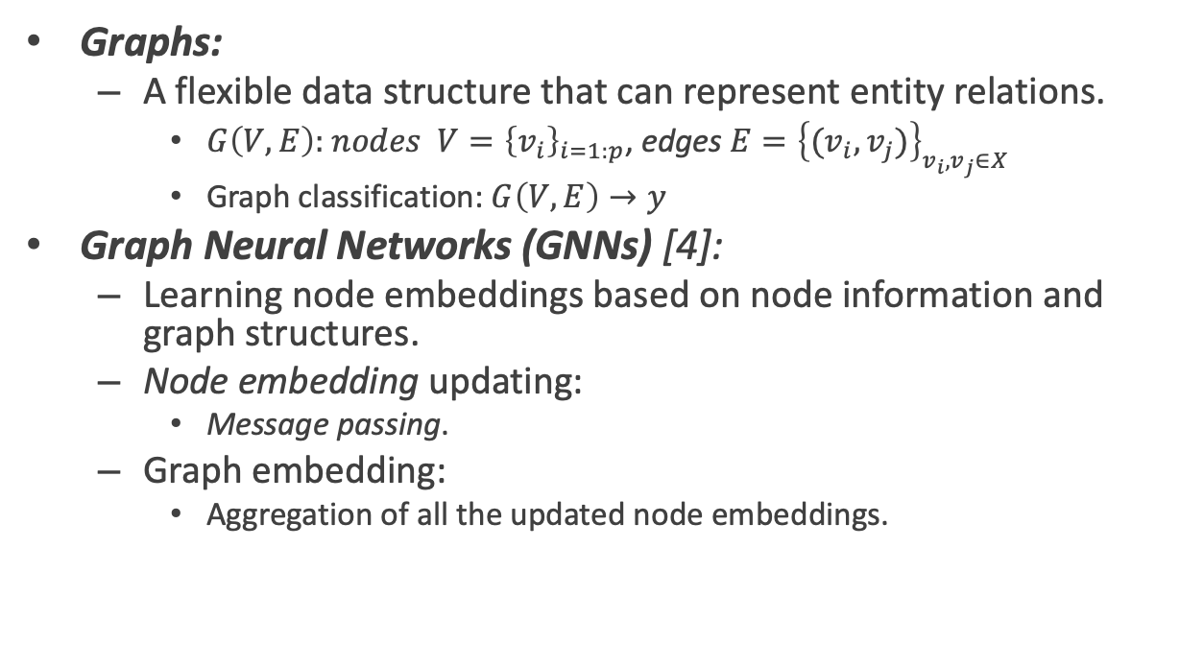
Background: Graph Neural Networks
Graphs:
A flexible data structure that can represent entity relations.
$G\left(V, E\right):$ $nodes$ $V={\left\{v_{i}\right\}}_{i=1:p}$, edges $E={\left\{(v_{i},v_{j})\right\}}_{v_{i},v_{j}∈X}$
Graph classification: $G\left(V, E\right)→y$
Graph Neural Networks (GNNs) [4]:
Learning node embeddings based on node information and graph structures.
Node embedding updating:
Message passing.
Graph embedding:
Aggregation of all the updated node embeddings.
Message passing
[4] Xu, et. al. How Powerful are Graph Neural Networks, ICLR 2019
Notes:
In this work, we propose our graph neural network based framework for explicit feature interaction modeling.
Two perform detection, we first need an effective explicit feature interaction modelling methods based on deep neural networks.
Inspired by graph neural networks, we propose a GNN based explicit feature interaction modelling algorithm.
All the four works are all based on one of our contributions – modelling feature interactions using graph neural neworks.
Therefore, we first talk about this technique.
Since GNNs gives us the flexibility to model each relations while message passing, we can explicitly model the relations using GNN.

Slide 58
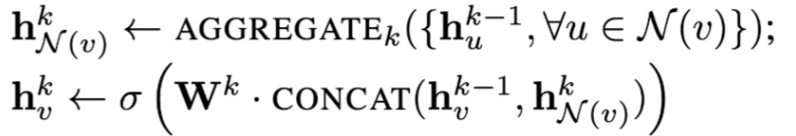
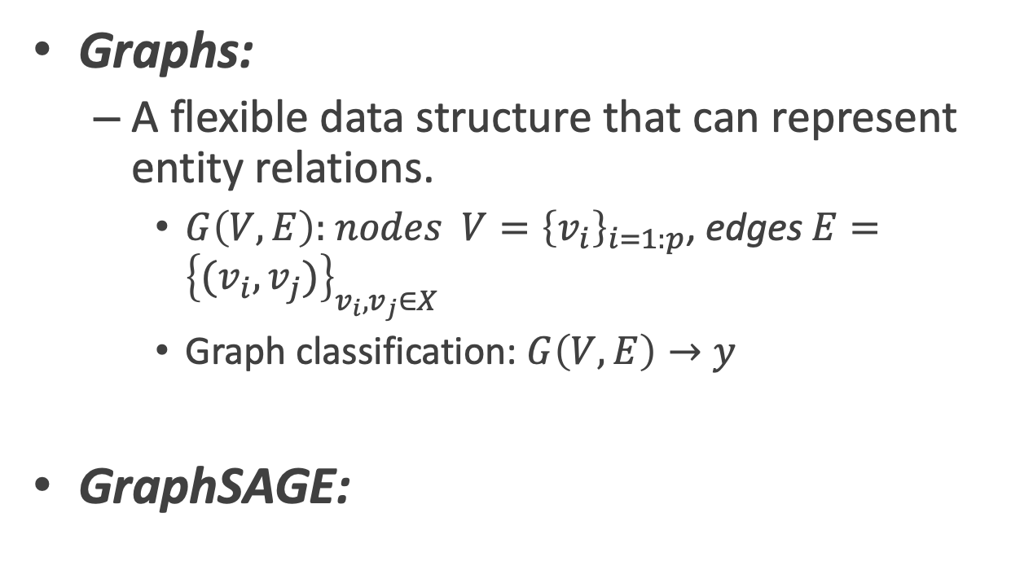
Background: Graph Neural Networks
Graphs:
A flexible data structure that can represent entity relations.
$G\left(V, E\right):$ $nodes$ $V={\left\{v_{i}\right\}}_{i=1:p}$, edges $E={\left\{(v_{i},v_{j})\right\}}_{v_{i},v_{j}∈X}$
Graph classification: $G\left(V, E\right)→y$
GraphSAGE:
Message passing

Slide 59
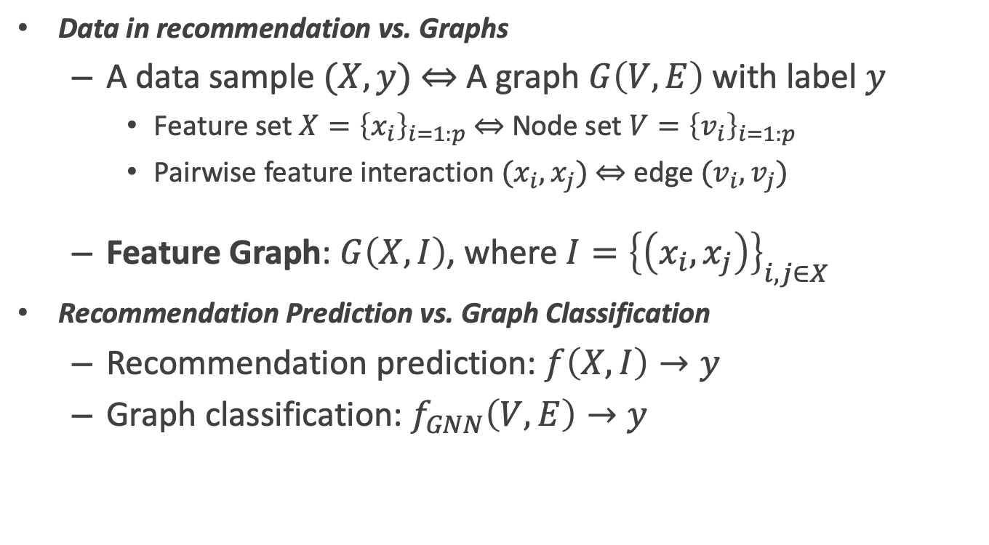
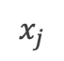
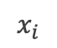
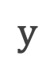
Explicit Feature Interaction Modelling vs. GNNs
Data in recommendation vs. Graphs
A data sample $(X, y)$ $⇔$ A graph $G\left(V, E\right)$ with label $y$
Feature set $X{=\left\{x_{i}\right\}}_{i=1:p} ⇔$ Node set $V{=\left\{v_{i}\right\}}_{i=1:p}$
Pairwise feature interaction $(x_{i},x_{j})$ $⇔$ edge $(v_{i},v_{j})$
Feature Graph: $G\left(X, I\right)$, where $I={\left\{\left(x_{i},x_{j}\right)\right\}}_{i,j∈X}$
Recommendation Prediction vs. Graph Classification
Recommendation prediction: $f\left(X,I\right)→y$
Graph classification: $f_{GNN}\left(V,E\right)→y$
$$x_{j}$$
$$x_{i}$$
$$y$$
Figure 4. Recommendation prediction can be considered as graph classification.
Notes:
What type of the protein is. enzymes non-enzymes

Slide 60
Motivation
Most feature interaction-based methods considers all feature interactions
Not all feature interactions are beneficial to the recommendation result.
Style
Beneficial feature interactions
?
Color
Texture
User
Item
Unbeneficial feature interactions
Brand
Figure 5. Some feature interactions are unbeneficial for recommendation

Slide 61
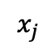


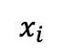
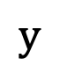
Our Approach
Our Goal in graph form:
Beneficial feature interaction detection
Edge prediction
Feature interaction-based recommendation prediction
Graph classification
$$x_{j}$$
$$?$$
$$?$$
$$x_{i}$$
$$y$$
Figure 6. Our model contains an edge prediction task and a graph classification task.

Slide 62
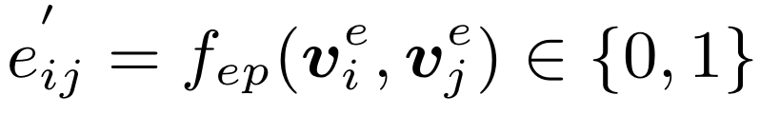

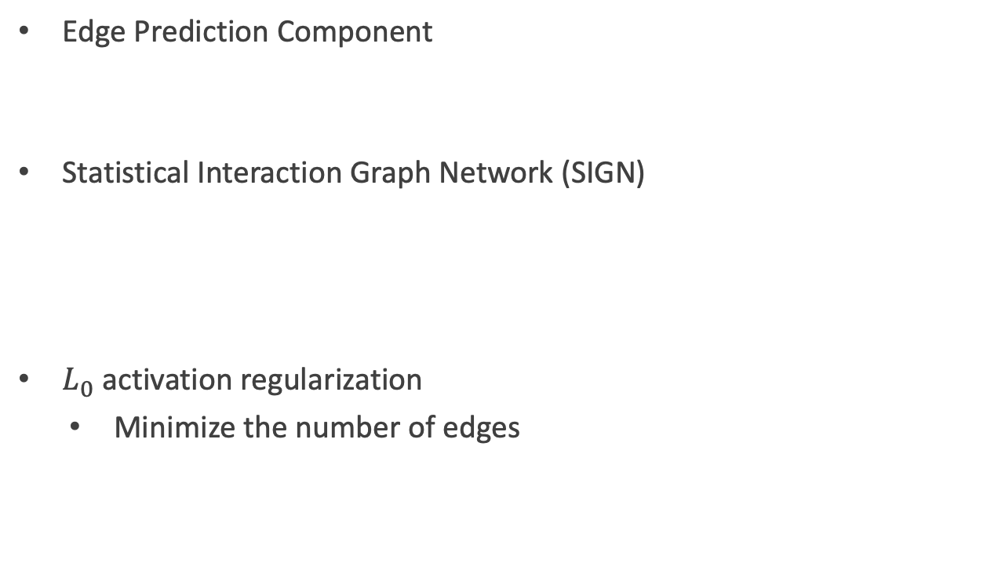
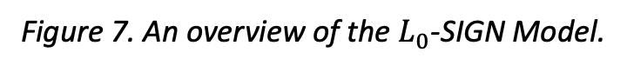
Our Approach: $L_{0}$-SIGN
Edge Prediction Component
Statistical Interaction Graph Network (SIGN)
$L_{0}$ activation regularization
Minimize the number of edges
Figure 7. An overview of the $L_{0}$-SIGN Model.
Notes:
Instead of linearly perform the message passing, we use a non-linear method h (MLP) to model each beneficial feature interaction.

Slide 63
Experiments
We can perform recommendations via the predicted pairwise beneficial feature interactions.
Figure 7. A case study on whether a user (u349) will use an app (Gmail) given features.
Notes:
The explicit feature interaction modelling using GNNs provide potential to explain the recommendation results.

Slide 64
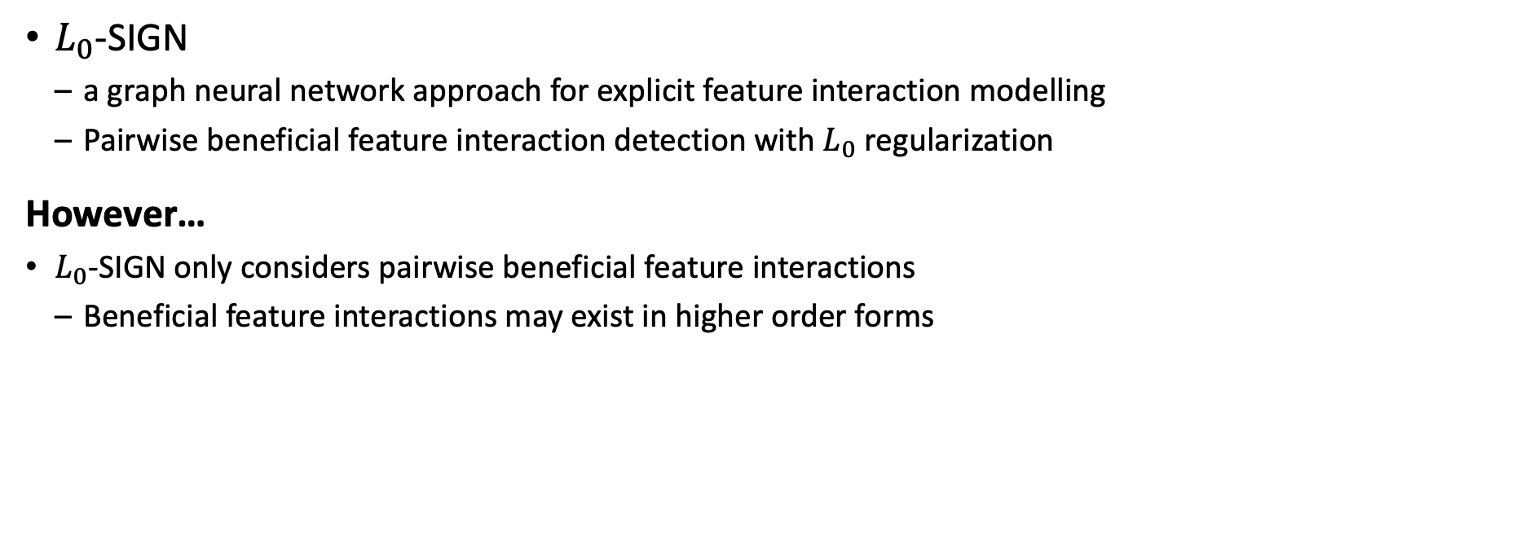
Summary
$L_{0}$-SIGN
a graph neural network approach for explicit feature interaction modelling
Pairwise beneficial feature interaction detection with $L_{0}$ regularization
However…
$L_{0}$-SIGN only considers pairwise beneficial feature interactions
Beneficial feature interactions may exist in higher order forms

Slide 65
Arbitrary order beneficial feature interaction detection (HIRS)
SIGKDD 2022

Slide 66
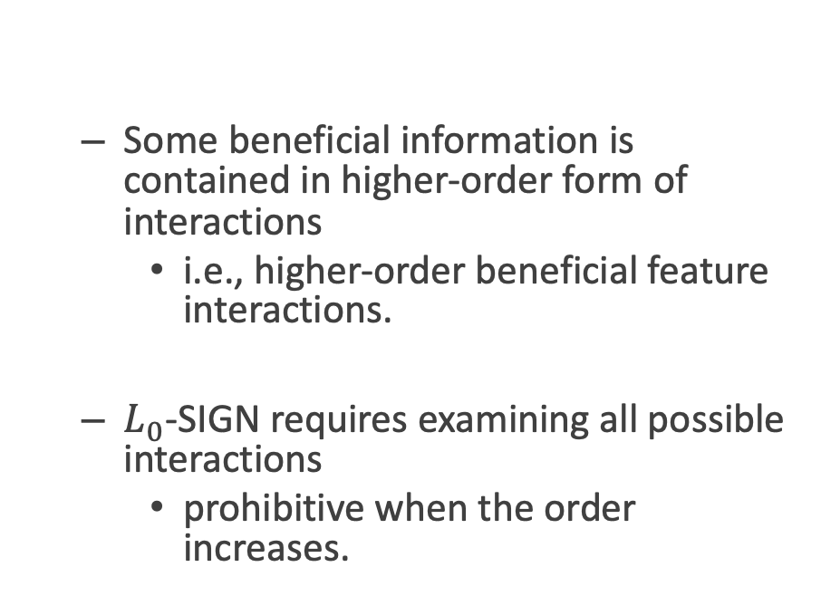
Motivation
Some beneficial information is contained in higher-order form of interactions
i.e., higher-order beneficial feature interactions.
$L_{0}$-SIGN requires examining all possible interactions
prohibitive when the order increases.
Figure 8. Existing studies detect beneficial feature interaction via examining all possible ones.
Notes:
The number of high-order feature interactions increase exponentially with the order increasing.

Slide 67
Our Approach: HIRS
We propose to directly generate arbitrary-order beneficial feature interactions.
To ensure the generating effectiveness, we propose mutual information maximization-based methods (s-Infomax and Infomin).
Figure 9. We propose to detect beneficial feature interactions by directly generating them.

Slide 68
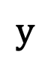
Our Approach: HIRS
Beneficial feature interaction detection
Three properties of beneficial feature interactions based on information theory:
Sufficiency
Low redundancy
Disentanglement
s-Infomax and Infomin
ensure the detected beneficial feature interactions fits the three properties
Interaction Learning for recommendation
Represent as a feature
hypergraph.
An interaction-based hypergraph neural network (IHGNN).
$$y$$

Slide 69
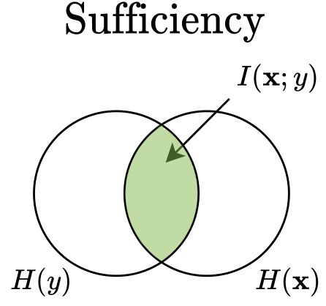
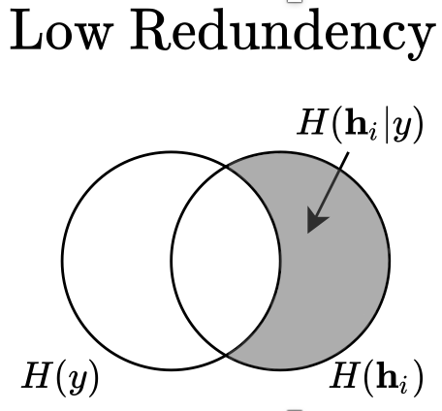
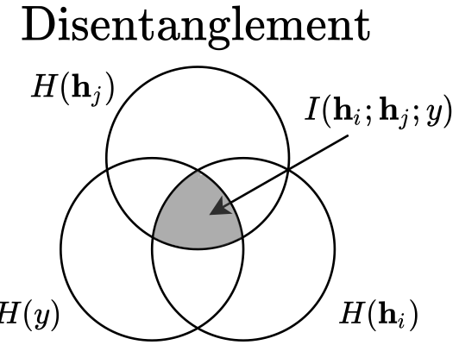
Our Approach: HIRS
Three properties of beneficial feature interactions
Sufficiency
Low redundancy
Disentanglement
All beneficial feature interactions together contain as much relevant information about the true output as possible.
Each beneficial feature interaction contains as less irrelevant information about the true output as possible.
Any two beneficial feature interactions contain as less duplicated relevant information about the true output as possible.

Slide 70
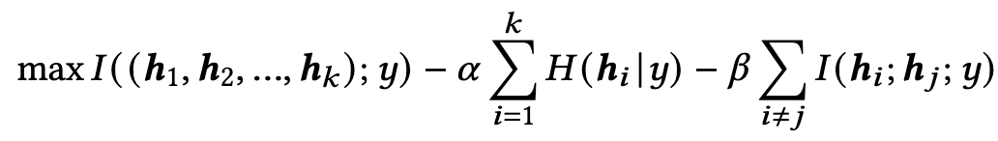
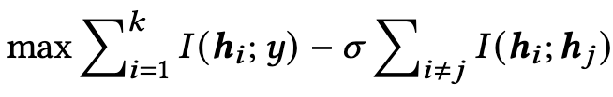
Our Approach: HIRS
Objective function:
Mutual information maximization and minimization-based approximation:
Sufficiency
Low Redundancy
Disentanglement
s-Infomax
Infomin

Slide 71
Our Approach: HIRS
Figure 10. An overview of the HIRS model.
Notes:
L0 regularization minimize the number of nodes that each hyperedge links to.

Slide 72
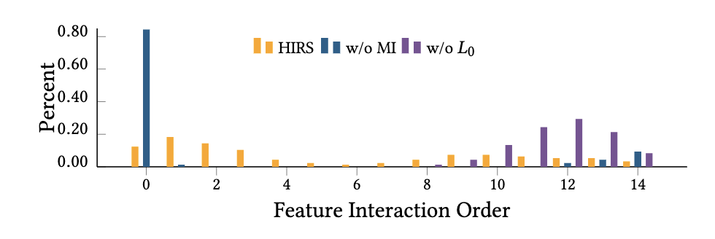
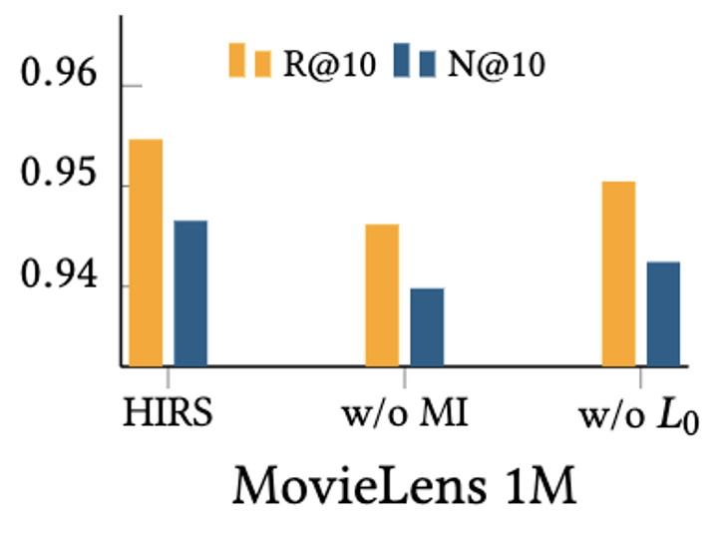
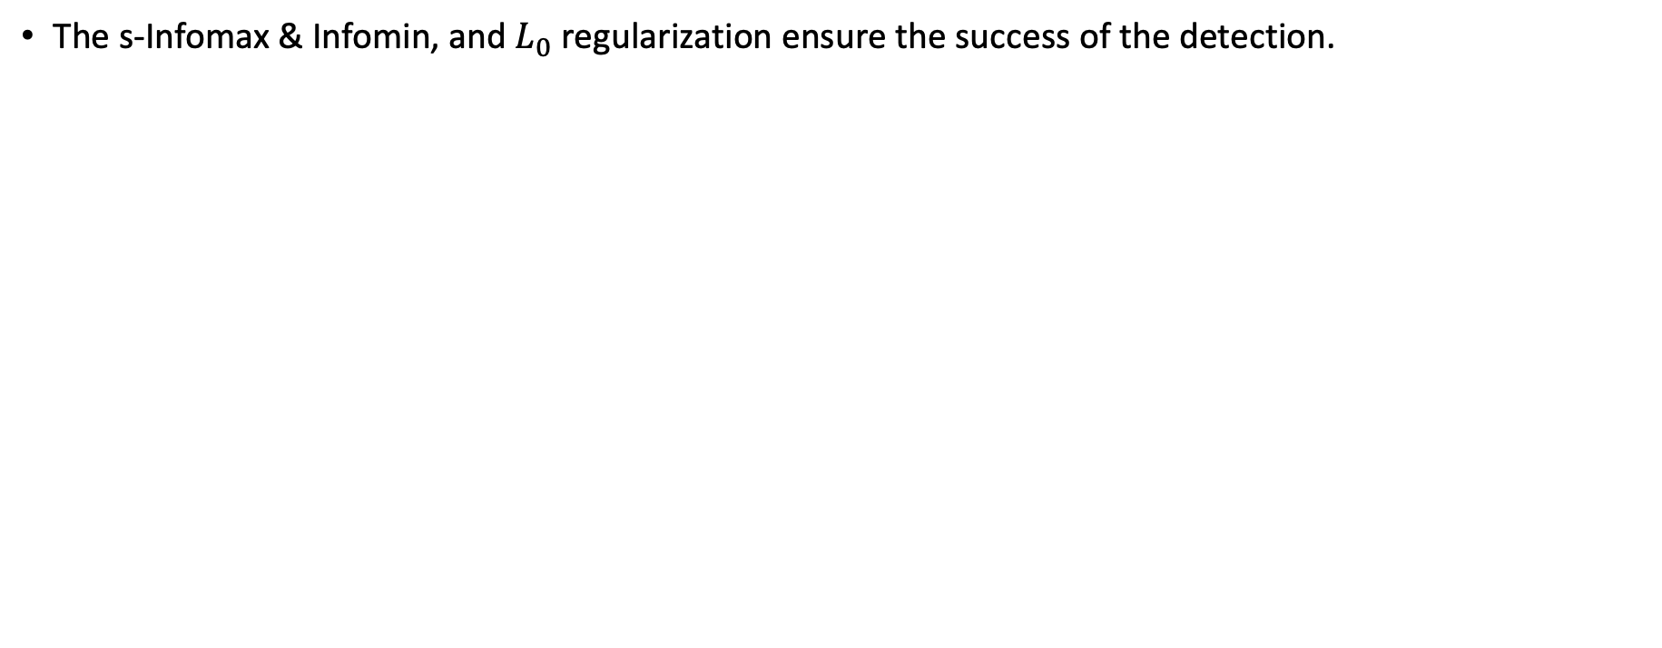
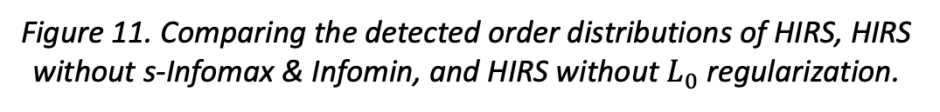
Experiments
The s-Infomax & Infomin, and $L_{0}$ regularization ensure the success of the detection.
Figure 11. Comparing the detected order distributions of HIRS, HIRS without s-Infomax & Infomin, and HIRS without $L_{0}$ regularization.
Figure 12 Comparing the performance with different component removed.
Notes:
Ablation studies.
Without any part cannot give a success prediction.
1) Without MI predict many 0 order interactions and a few are very high order, meaning most of the edges are empty and all the information are aggregated in several edges.
2) Whtout L0 cause the predicted feature interaction are very high, meaning feature interactions mixed together and there are redundant information.

Slide 73
Summary
Directly generate arbitrary order beneficial feature interactions
Three properties: sufficiency, low redundancy, disentanglement
s-Infomax and Infomin methods
Interaction-based hypergraph neural network
An extension of our SIGN model
Arbitrary order feature interactions as hyperedges

Slide 74
06
Large Language Model Principles Visualization

Slide 75

Large Language Model
Natural Language Processing (NLP)
Large Language Models (LLMs) like GPT (Generative Pre-trained Transformer) and BERT (Bidirectional Encoder Representations from Transformers) are advanced AI algorithms designed to understand, generate, and manipulate human language based on vast amounts of text data.
Large Language Model (LLM)
Large Language Models (LLMs) like GPT (Generative Pre-trained Transformer) and BERT (Bidirectional Encoder Representations from Transformers) are advanced AI algorithms designed to understand, generate, and manipulate human language based on vast amounts of text data.

Slide 76



Attention
unimportant information remained
What is Attention
Recommender systems are algorithms designed to suggest relevant items to users (like books, movies, or products) based on their past preferences and behaviors. These systems are prevalent in e-commerce and online media sites, enhancing user experience by personalizing content.
An image with whole information
Important information remained

Slide 77
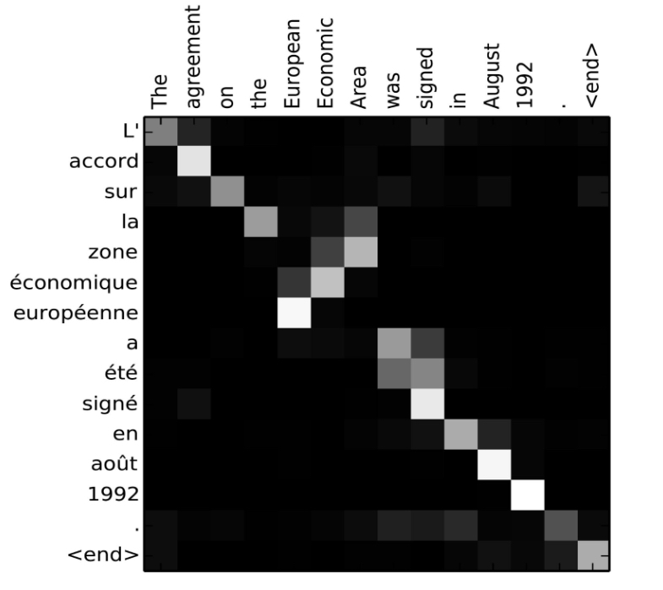
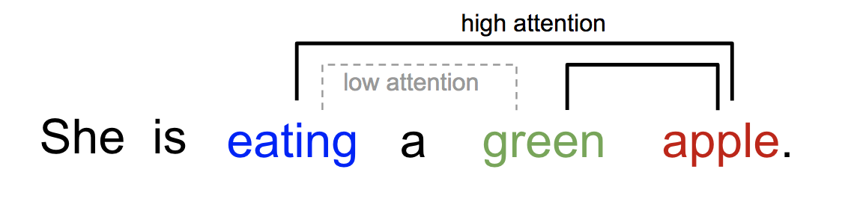
Attention
Attention in NLP
Attention in NLP tasks search for the correlations inside the sentences or between two sets of sentences.

Slide 78
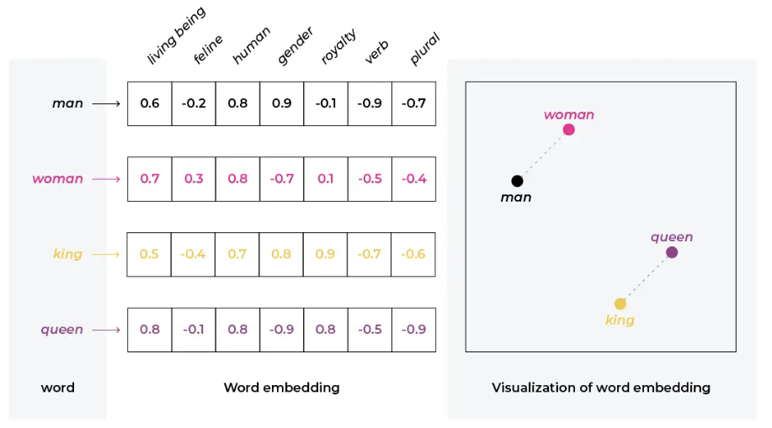





Attention Calculation
2. Attention $≈$ dot product
1. Tokens (words) --> Embeddings
Embedding 1
Embedding 2
Attention score
.
$$×$$
$$=$$
Embedding 4
Embedding 5
Embedding 6
Embedding 1
.
Embedding 2
.
$$×$$
$$=$$
Embedding 3
.

Slide 79


Transformer

Slide 80


Transformer

Slide 81

THANKS
FOR WATCHING
Email: yixin.su@outlook.com WeChat: Ethan

